Slide 1
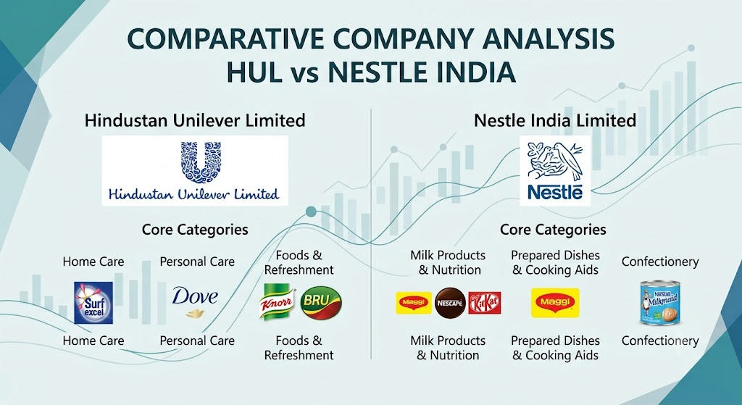

Slide 2
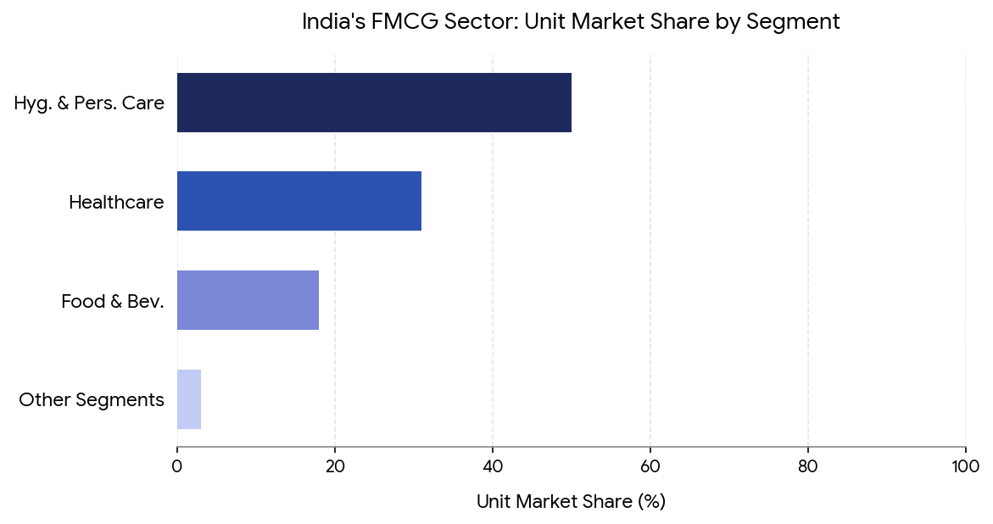
India's FMCG Sector: A High-Growth Consumer Engine
India is the world's 4th largest FMCG market, contributing approximately 3% of national GDP. The sector provides livelihood to over 3 million people through direct and indirect employment, making it one of India's most critical economic engines.
The market spans four primary segments: Household Care (~45% share, essentials), Personal Care (~31% share, grooming), Food and Beverages (~22% share, processed foods), and Healthcare (urban/rural wellness). Rising incomes, urbanization, and digital adoption are accelerating demand.
~US$ 160 Billion total annual market size (2024E), growing at strong CAGR
~3% contribution to India's GDP
3M+ direct and indirect jobs supported
4th largest sector in the Indian economy.

Slide 3
Company at a Glance
COMPANY PROFILES
Hindustan Unilever Ltd (HUL)
Nestle India
Founded & HQ
Founded & HQ
1933 | Mumbai | Parent: Unilever PLC (UK)
1961 | Gurugram | Parent: Nestle S.A. (Switzerland)
Business Segments
Business Segments
Home Care · Beauty & Personal Care ·
Foods & Refreshment
Milk Products & Nutrition · Prepared Dishes ·
Confectionery · Beverages
Brand Portfolio
Brand Portfolio
50+ brands — Surf Excel, Dove, Lux, Lifebuoy,
Horlicks, Knorr, Lakme, Pepsodent
Maggi · KitKat · Munch · Nescafé · Milkmaid ·
Nestlé NAN · Milo
Market Cap (FY24)
Market Cap (FY24)
~₹5.5 Lakh Crore | Revenue (FY24): ~₹62,000 Cr
~₹2.3 Lakh Crore | Revenue (FY24): ~₹17,000 Cr
Distribution Scale
Distribution Scale
9M+ retail outlets; rural reach spanning 700,000+
villages across India
5M+ outlets; strong urban and semi-urban penetration;
limited rural depth

Slide 4

FINANCIAL DASHBOARD
Revenue & Profit Performance: FY2021–FY2026
Revenue CAGR
HUL
Nestle India
₹ 47,028.0 Cr (FY21) → ₹ 64,468.0 Cr (FY26) | CAGR ~37%
₹ 14,740.5 Cr (FY21)
→ ₹ 23,154.60 Cr (FY26) |
Net Profit CAGR
HUL
Nestle India
₹ 7,829.00 Cr (FY21) → ₹ 10,136.00 Cr (FY26) |
₹ 2,230.8 Cr (FY21) → ₹ 3,384.4 Cr (FY26)
EBITDA Margins
HUL: 22–24% consistently | Nestle: 22–26%; expansion driven by premiumisation
Dividend Policy
HUL: 90%+ payout ratio — consistent dividend aristocrat over 20+ years
Nestle: 100%+ payout with special dividends declared in FY22 and FY23

Slide 5

RATIO ANALYSIS
Margin Comparison
Gross Profit Margin
Net Profit Margin
HUL: 48–52% | Nestle: 55–58%
Nestle commands superior gross margins driven by its premium product mix and focused SKU portfolio.
HUL: 15–17% | Nestle: 16–21%
Nestle's margin trajectory is steeper, reflecting meaningful operating leverage as revenues scale.
Capital Efficiency
Return on Equity (ROE)
Return on Capital Employed (ROCE)
HUL: 18–22% | Nestle: 90–110%
Nestle's asset-light, negative working capital model drives an exceptionally high ROE — a structural competitive advantage.
HUL: 25–30% | Nestle: 60–80%
Nestle is significantly more capital-efficient across the entire study period.
EPS Growth
Nestle's ROE of 110% vs. HUL's 21% is not a marginal difference — it reflects a fundamentally different business model. Nestle's negative working capital means suppliers effectively finance its operations, amplifying returns on equity dramatically.
HUL: ₹22.8 (FY21) → ₹43.7 (FY26) | CAGR ~18%
Nestle: ₹215 (FY21) → ₹373 (FY26) | CAGR ~15%

Slide 6


RATIO ANALYSIS
Liquidity & Solvency: Both Companies Are Financially Strong
Current Ratio
Quick Ratio
Debt-to-Equity
HUL: 0.8–1.0x
Nestle: 0.6–0.8x
Both operate around 1x — a hallmark of FMCG businesses with strong supplier credit terms and negative working capital.
HUL: 0.6–0.8x
Nestle: 0.5–0.7x
Adequate for FMCG operations; high inventory turns mean liquidity is not a concern despite sub-1x ratios.
HUL: Near zero — virtually debt-free
Nestle: Minimal long-term debt; lease liabilities under Ind AS 116
Both companies self-fund operations from internal accruals.
Interest Coverage Ratio
Cash Conversion Cycle
Key Analyst Insight: Both companies are financially fortress-like. Solvency is NOT a differentiator between HUL and Nestle India. The investment thesis must be built on profitability trajectories, capital efficiency, and strategic positioning — not balance sheet risk.
HUL: 30x+
Nestle: 30x
Both companies carry negligible financial risk. Interest expense is a rounding error relative to operating profit.
HUL: Negative (~-20 days) Nestle: Negative (~-15 days)
Suppliers effectively finance operations for both companies — a structural advantage that amplifies capital efficiency.
What Differentiates Them
ROE, ROCE, Net Margin expansion, and long-term stock return are the true battlegrounds for this comparison.

Slide 7

TREND ANALYSIS
FY2025–26 Performance Trajectory
Revenue & Margin Trends
Revenue Trend
HUL grew faster in absolute terms post-GST and post-COVID recovery. Nestle accelerated from FY22 onward driven by Maggi premiumisation and the recovery of out-of-home food consumption.
Margin Trend
Both companies faced raw material headwinds in FY22 — palm oil, wheat, and packaging inflation. HUL absorbed the impact via pricing power; Nestle recovered faster owing to its narrower, focused SKU portfolio.
Volume vs. Price Growth
Capex & Investment
HUL Capex
Nestle Capex
₹2,000 Cr/year
Focused on capacity expansion, technology upgrades, and supply chain optimization.
₹650–700 Cr/Year
Continued investment in manufacturing capacity, automation, and operational efficiency across plants.

Slide 8
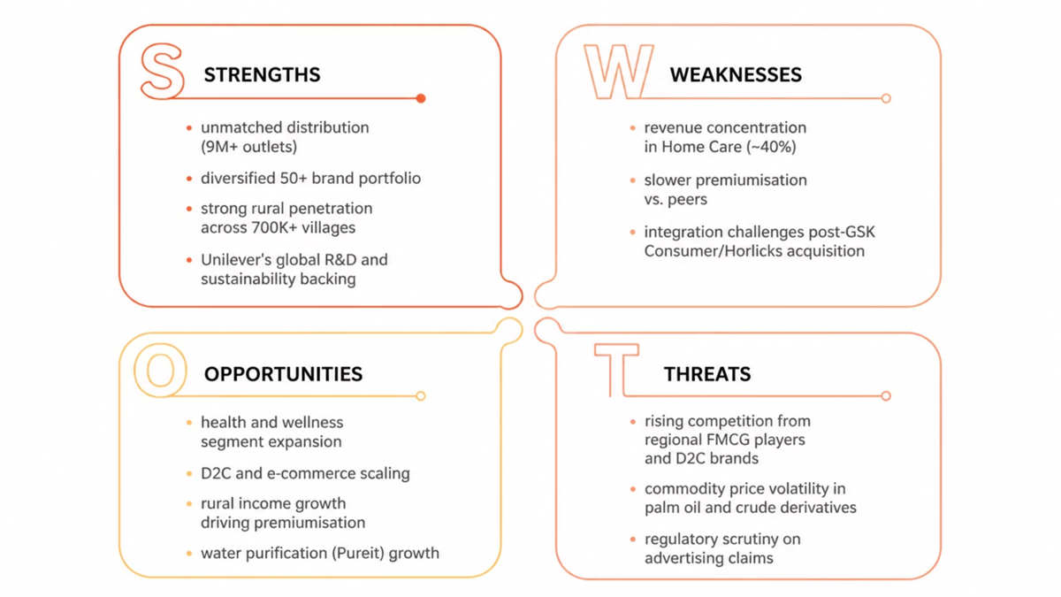
SWOT ANALYSIS
SWOT Analysis: Hindustan Unilever Ltd

Slide 9
SWOT Analysis: Nestle India

Slide 10
WINNER ANALYSIS
Head-to-Head Scorecard
Parameter HUL Nestle India Winner
Revenue Scale ₹62,000Cr ₹17,000 Cr ✅ HUL
Net Profit Margin 16.6% 21.2% ✅ Nestle
Return on Equity (ROE) 21% 110% ✅ Nestle
5-Year Stock Return ~45% ~120% ✅ Nestle
Dividend Payout 90%+ 100%+ ✅ Nestle
Portfolio Breadth 50+ brands ~30 brands ✅ HUL
Rural Penetration 9M+ outlets 5M+ outlets ✅ HUL

Slide 11
✅ HUL Wins On
✅ Nestle Wins On
Revenue scale, portfolio diversification, rural distribution depth, and dividend consistency over 20+ consecutive years. HUL is the scale and resilience play — lower concentration risk with India's most extensive FMCG footprint.
Net profit margin, ROE, ROCE, 5-year stock returns, and dividend payout ratio. Nestle is the financial efficiency and wealth-creation play — superior returns on every rupee of capital deployed, driven by its negative working capital model and premium brand positioning.

Slide 12
Key Takeaway
✔ HUL dominates in market reach.
✔ Nestlé generates higher shareholder returns.
✔ Both companies maintain low financial risk.
✔ HUL's diversified portfolio reduces business risk.
✔ Nestlé's focused strategy improves profitability.

Slide 13
KEY FINDINGS
Conclusions & Investment Takeaways
Scale vs. Efficiency Realignment
HUL continues to lead on absolute scale with ₹63,763 Cr in turnover, leveraging a massive physical network. While Nestle still wins on raw efficiency metrics, its capital base dilution (including a 1:1 bonus share issue in 2024–2026) lowered its historic triple-digit ROE down to 73.2%.
2. Margin Squeezes & Volume Prioritization
The commodity inflation shock extended well past FY22. By FY25–FY26, both companies encountered a structural urban demand slowdown. HUL adjusted its playbook to prioritize volume growth over sheer pricing power, while Nestle's margins took hits from unprecedented cocoa and coffee price spikes.
3. Shift in Capital Allocation
HUL remains debt-free with a steady 92%+ dividend distribution pattern. Conversely, Nestle moved away from its 100%+ payout ratio baseline, opting to aggressively reinvest profits into domestic product expansion and manufacturing capital expenditure.
4. Investor Returns & Re-Rating
The massive wealth-creation gap where Nestle outperformed HUL by 2.7x slowed down. Slower premium packaged food growth and localized margin pressures led to a stock price cooling period for Nestle, aligning its trading multiples closer to traditional defensive FMCG benchmarks.
5. Diversification vs. Brand Dependency
Nestle worked to broaden its portfolio mix to reduce its structural reliance on Maggi noodles (~30%+ revenue bucket). However, HUL remains the fundamentally lower-risk profile, as its top brands are widely distributed across diverse, insulated home and personal care categories.

